Slide 1
JDK,JRE,JVM,Internal Execution,Data Types
Created By: Rahul Majukar

Slide 2
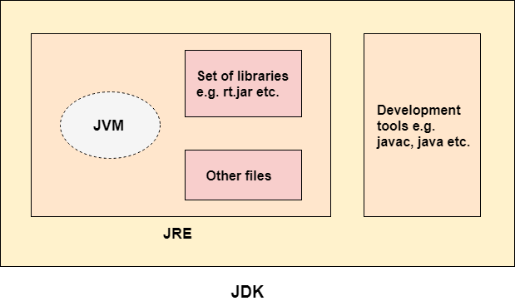
JDK
The Java Development Kit (JDK) is a software development environment which is used to develop Java applications.
It is possible to install more than one JDK versions on the same computer
Can be installed on all the platform’s (windows, Linux, mac etc..)
It physically exists.
Jdk=JRE + Development tools.

Slide 3
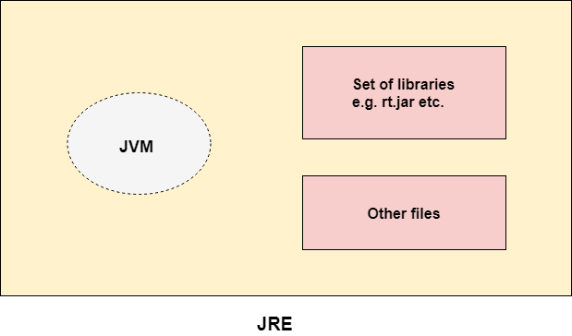
JRE(Java Runtime Environment)
The Java Runtime Environment is a set of software tools which are used for developing Java applications.
It is used to provide the runtime environment. It is the implementation of JVM.
A partition of region is created during runtime.
It contains a set of libraries + other files that JVM uses at runtime.
JRE = JVM + Library classes.
Libraries will be at java\jre\lib
All basic lib are @ java\jre\lib\rt.jar\java

Slide 4
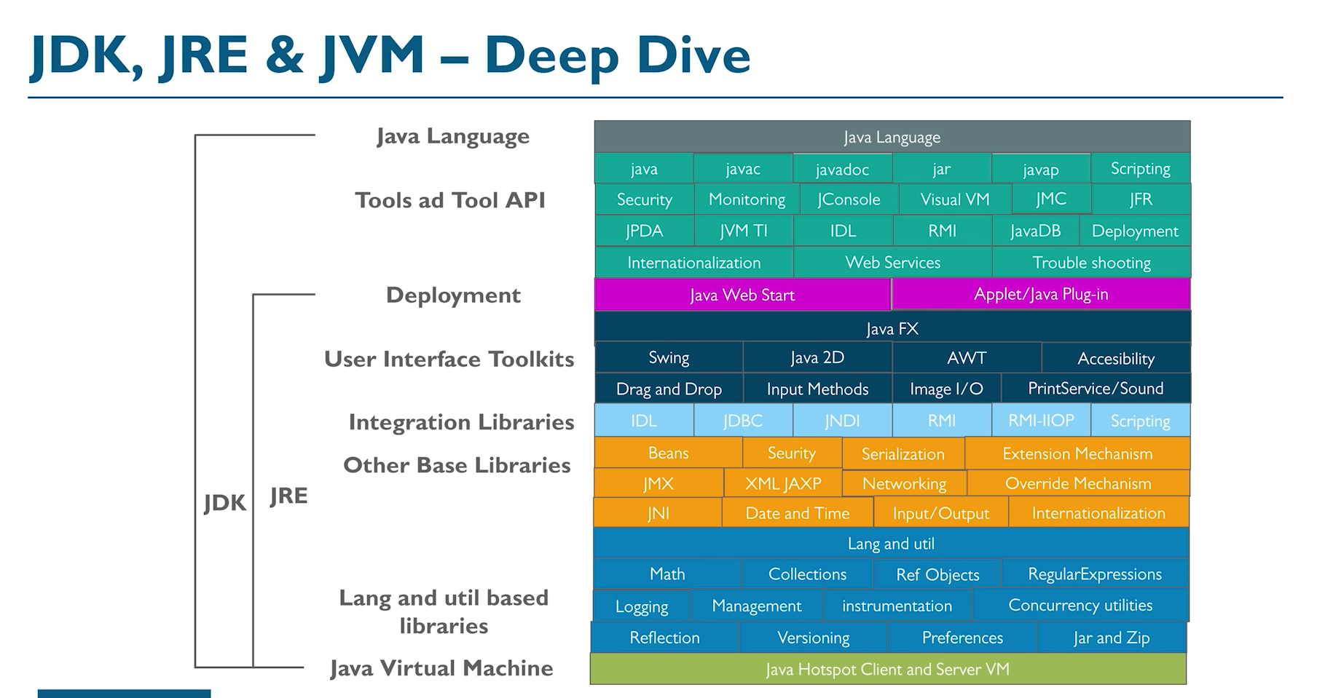

Slide 5
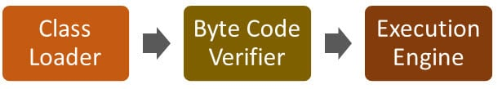
JVM(Java Virtual Machine)
It is called a virtual machine because it doesn't physically exist.
that provides a runtime environment in which Java bytecode can be executed.
JVMs are available for many hardware and software platforms.
It converts Java bytecode into machines language

Slide 6
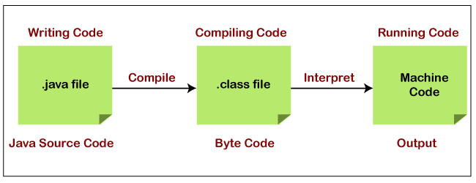
Java Interpreter
Java interpreter is a computer program (system software) that implements the JVM.
The Java interpreter converts the Java bytecode (.class file) into the code understand by the operating system(MLL).
It is responsible for reading and executing the program.

Slide 7
JIT(Just In Time) compiler
It is enabled by default when a method is invoked. The JVM directly invokes the compiled code of the method without interpreting it.
It does not require much memory usage, remove redundant code
Class Loader
part of the Java Runtime Environment that dynamically loads Java classes into the Java Virtual Machine
Byte Code Verifier
restricts to perform actions that are obviously damaging

Slide 8
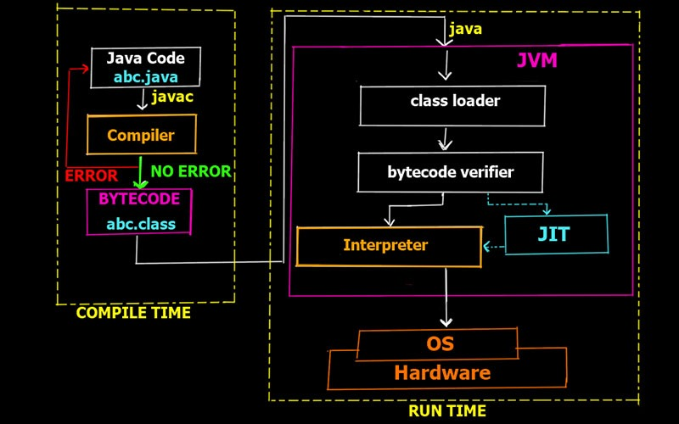
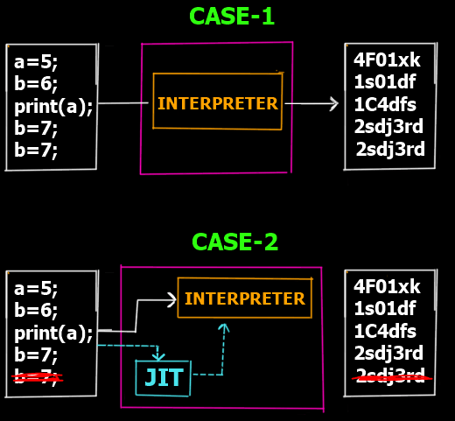
Execution of a Java Program Internally

Slide 9
Java Comments
Comments can be used to explain Java code, and to make it more readable.
Single-line Comments:
Single-line comments start with two forward slashes (//)
Java Multi-line Comments:
Multi-line comments start with /* and ends with */
Any text between /* and */ will be ignored by Java.

Slide 10
Java Variables
Variables are containers for storing data values.
Variable is a name of memory location
Syntax: type variableName = value;
Data types of variables
String - stores text, values are surrounded by double quotes
int - stores integers, without decimals, such as 123 or -123
float - stores floating point numbers, with decimals, such as 19.99 or -19.99
char - stores single characters, such as 'a' or 'B'. Char values are surrounded by single quotes
boolean - stores values with two states: true or false

Slide 11
Java Variables Types
1) Local Variable
A variable declared inside the body of the method is called local variable.
A local variable cannot be defined with "static" keyword.
2) Instance Variable
A variable declared inside the class but outside the body of the method, is called an instance variable.

Slide 12
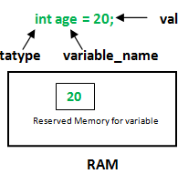
Java Variables Types
3) Static variable
A variable that is declared as static is called a static variable.
It cannot be local variable.
You can create a single copy of the static variable

Slide 13
Java Variables
public class A
{
int data=50; //instance variable
static int m=100; //static variable
void method()
{
int n=90; //local variable
}
public static void main(String args[])
{
int myNum=50; //local variable
}
}

Slide 14
Final Variables
When the variable is declared as final, the value of the variable cannot be changed
this will declare the variable as "final" or "constant", which means unchangeable and read-only
Ex:
final int speedlimit=90; //final variable
speedlimit=120; //Compile Time Error

Slide 15
Data Types in Java
Data types specify the different sizes and values that can be stored in the variable
There are two types of data types in Java:
Primitive data types: The primitive data types include boolean, char, byte, short, int, long, float and double. A primitive type is predefined by the language and is named by a reserved keyword.
Non-primitive data types: The non-primitive data types include Class, Interface and Arrays, They cannot store the value of a variable directly in memory.
Point to remember:
Java is a statically-typed programming language. It means, all variables must be declared before its use. That is why we need to declare variable's type and name.

Slide 16
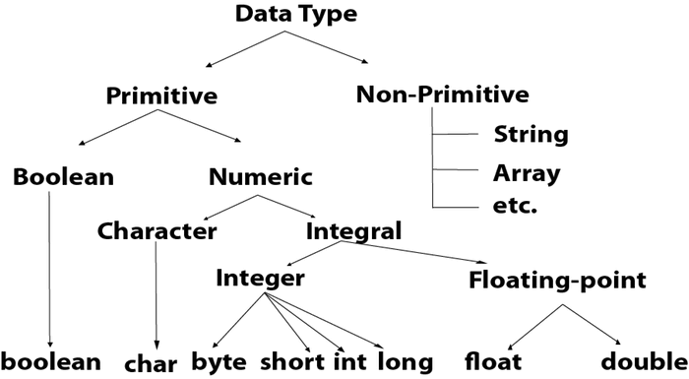
Data Types in Java

Slide 17
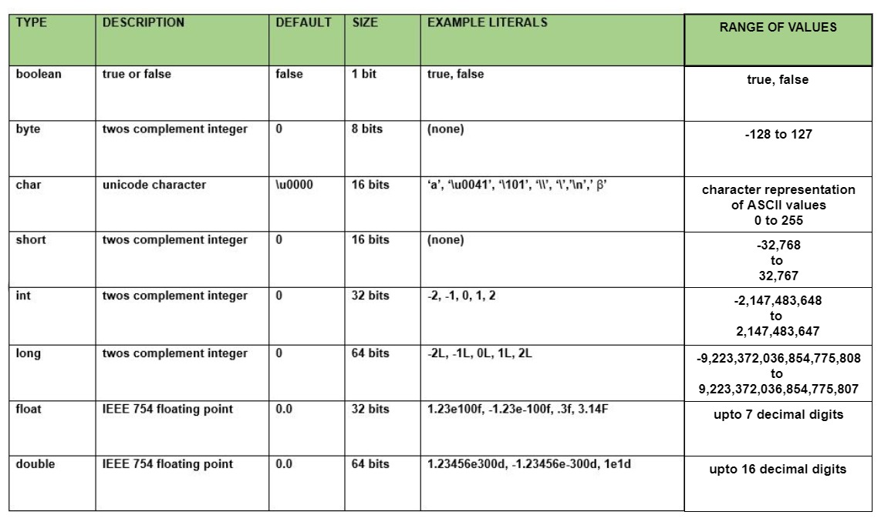

Slide 18
Java Data Types Example’s
int myNum = 5; // Integer (whole number)
float myFloatNum = 5.99f; // Floating point number
char myLetter = 'D'; // Character
boolean myBool = true; // Boolean
String myText = "Hello"; // String

Slide 19
Integer Types
Byte: The byte data type can store whole numbers from -128 to 127. This can be used instead of int or other integer types to save memory.
Example:
byte myNum = 100;
System.out.println(myNum);
Short: The short data type can store whole numbers from -32768 to 32767
Example:
short myNum = 100;
System.out.println(myNum);

Slide 20
Integer Types
Int: The int data type can store whole numbers from -2147483648 to 2147483647.
Example:
int myNum = 1000;
System.out.println(myNum);
Long: The long data type can store whole numbers from -9223372036854775808 to 9223372036854775807. This is used when int is not large enough to store the value. Note that you should end the value with an "L":
Example:
long myNum = 500000000L;
System.out.println(myNum);

Slide 21
Integer Types
float and double: You should use a floating point type whenever you need a number with a decimal, such as 9.99 or 3.14515.
The float and double data types can store fractional numbers. Note that you should end the value with an "f" for floats and "d" for doubles:
Example for float:
float myNum = 5.75f;
System.out.println(myNum);
Example for double:
double myNum = 19.99d;
System.out.println(myNum);
Note:The precision of float is only six or seven decimal digits, while double variables have a precision of about 15 digits. Therefore it is safer to use double for most calculations.

Slide 22
Integer Types
char: The char data type is used to store a single character. The character must be surrounded by single quotes, like 'A' or 'c’:
Example1:
char myGrade = 'B’;
System.out.println(myGrade);
Example2:
char myVar1 = 65, myVar2 = 66, myVar3 = 67;
System.out.println(myVar1);
System.out.println(myVar2);
System.out.println(myVar3);
java uses Unicode system not ASCII code system.
The \u0000 is the lowest range of Unicode system.
java uses 2 byte for characters

Slide 23
Integer Types
boolean: data type, which can only take the values true or false.
Boolean values are used for conditional testing.
Boolean is by default false.
Example:
boolean isJavaFun = true;
boolean isFishTasty = false;
System.out.println(isJavaFun); // Outputs true
System.out.println(isFishTasty); // Outputs false

Slide 24
Non-Primitive Data Types
Non-primitive data types are called reference types because they refer to objects.
Primitive types are predefined (already defined) in Java. Non-primitive types are created by the programmer and is not defined by Java (except for String).
A primitive type has always a value, while non-primitive types can be null.
A primitive type starts with a lowercase letter, while non-primitive types starts with an uppercase letter.
The size of a primitive type depends on the data type, while non-primitive types have all the same size.
Examples of non-primitive types are String , Array, etc.

Slide 25
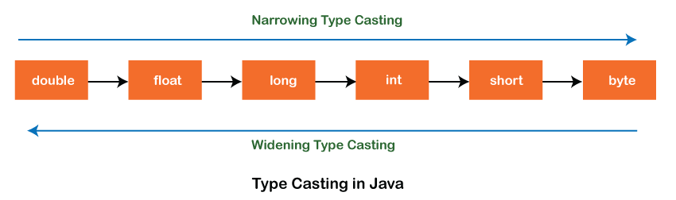
Type Casting
Type casting is a process that converts a data type into another data type in both ways manually and automatically. The automatic conversion is done by the compiler and manual conversion performed by the programmer.
Definition: Convert a value from one data type to another data type is known as type casting
There are two types of type casting:
Widening Type Casting
Narrowing Type Casting

Slide 26
Type Casting
Widening Type Casting
Converting a lower data type into a higher one is called widening type casting. It is also known as implicit conversion or casting down. It is done automatically. It is safe because there is no chance to lose data.
byte -> short -> char -> int -> long -> float -> double
Example:
int x = 7;
//automatically converts the integer type into long type
long y = x;
//automatically converts the long type into float type
float z = y;
Int
Long

Slide 27
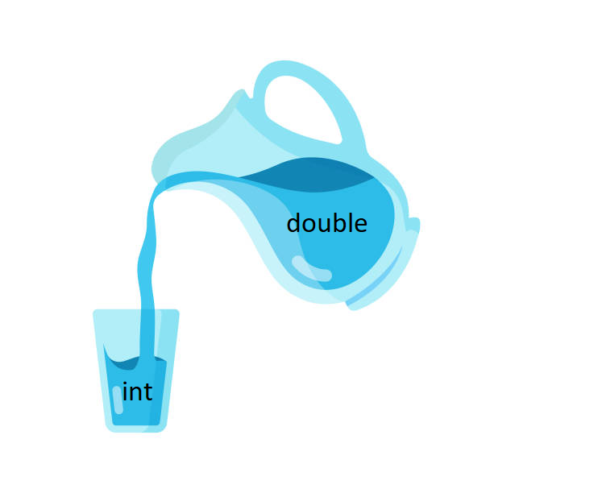
Type Casting
Narrowing Type Casting
Converting a higher data type into a lower one is called narrowing type casting. It is also known as explicit conversion or casting up. It is done manually by the programmer. If we do not perform casting then the compiler reports a compile-time error.
double -> float -> long -> int -> char -> short -> byte
Example:
double d = 166.66;
//converting double data type into long data type
long l = (long)d;
//converting long data type into int data type
int i = (int)l;

Slide 28
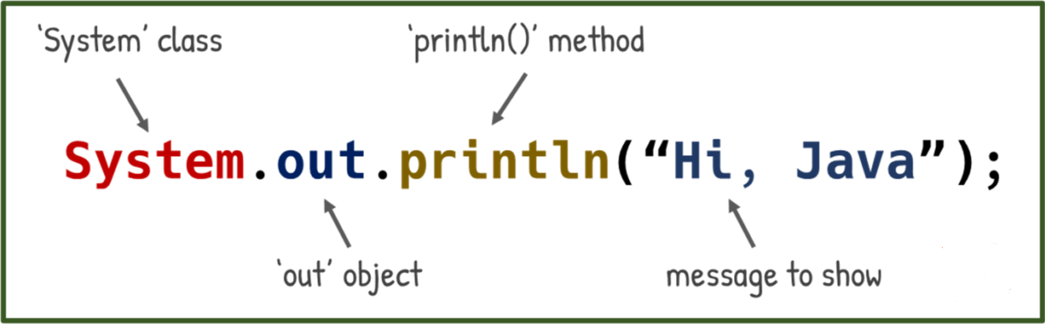
Structure of System.out.println()

